Slide 1
HOW TO BUILD INTERNATIONAL BUSINESS &MASSIVE ACTION
CONSISTENCY IS MORE IMPORTANT THAN PERFECTION

Slide 2


I HAVE BUILD BUSINESS IN TOW COUNTRIES
INDIA
NEPAL

Slide 3

IMPORTANT RULE

Slide 4
FOR BIG BUSINESS NEED SOMETHING
1. MAGIC CORNER
WT SYSTEM
BIG ROLE OF CEP
REGURAL ACTIVITY
ONE TO ONE MEETING
HOME MEETING

Slide 5
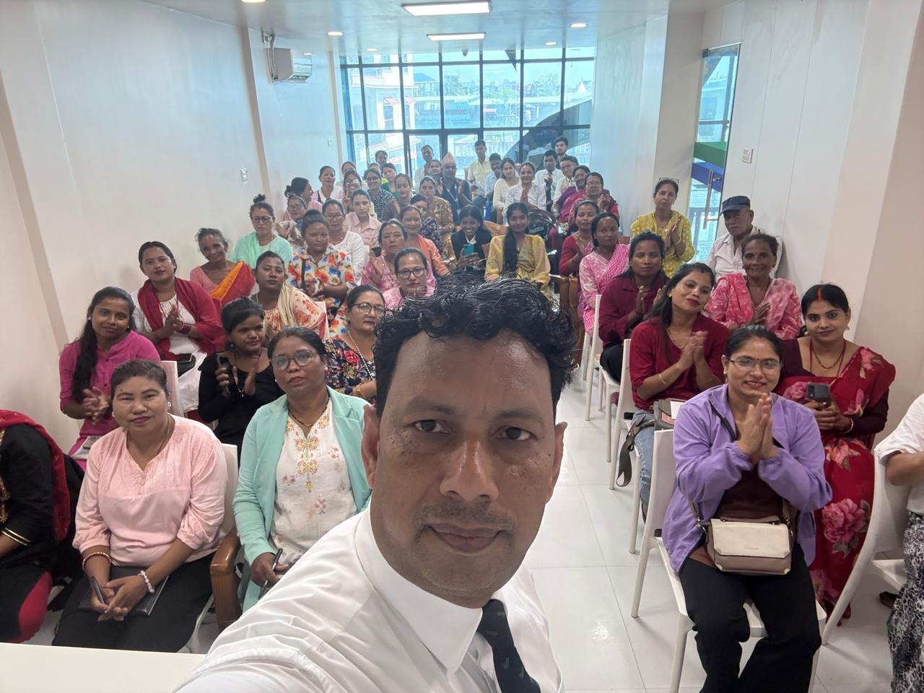
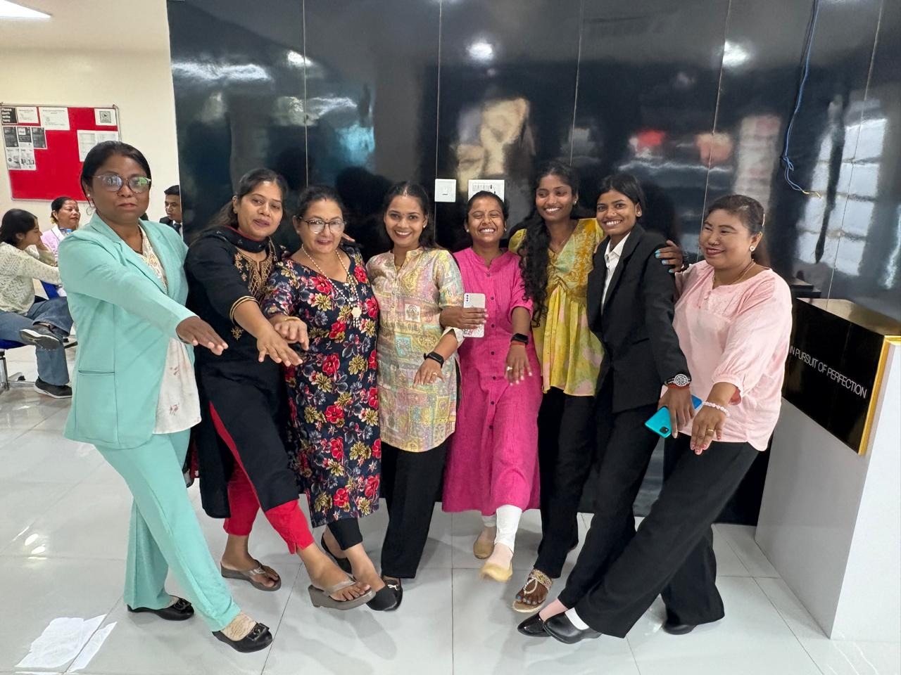
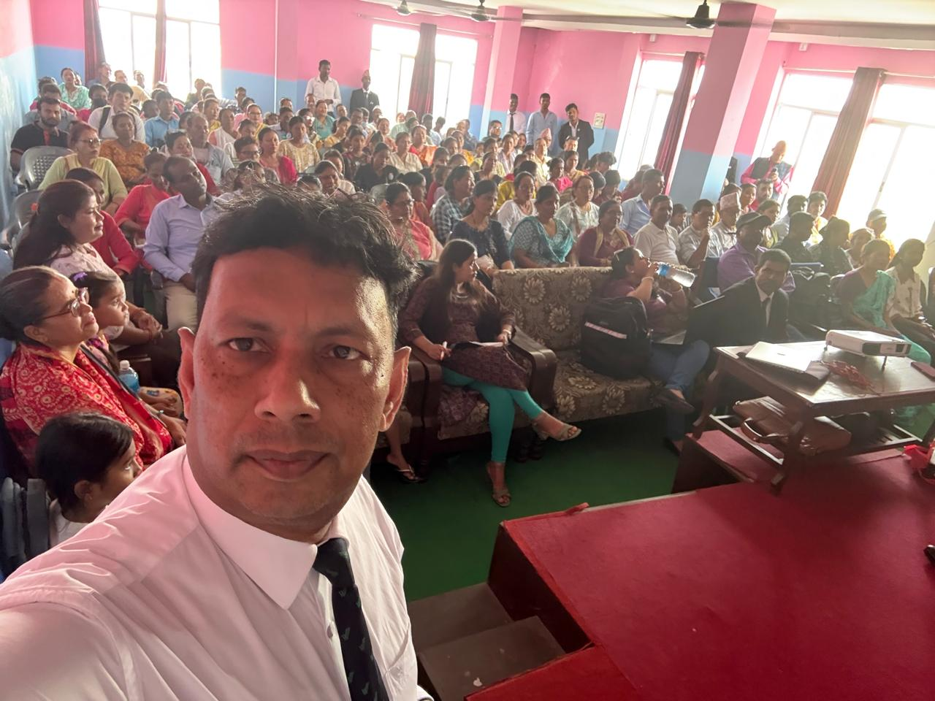
SOME NEPAL BUSINESS MEETING PHOTO

Slide 6
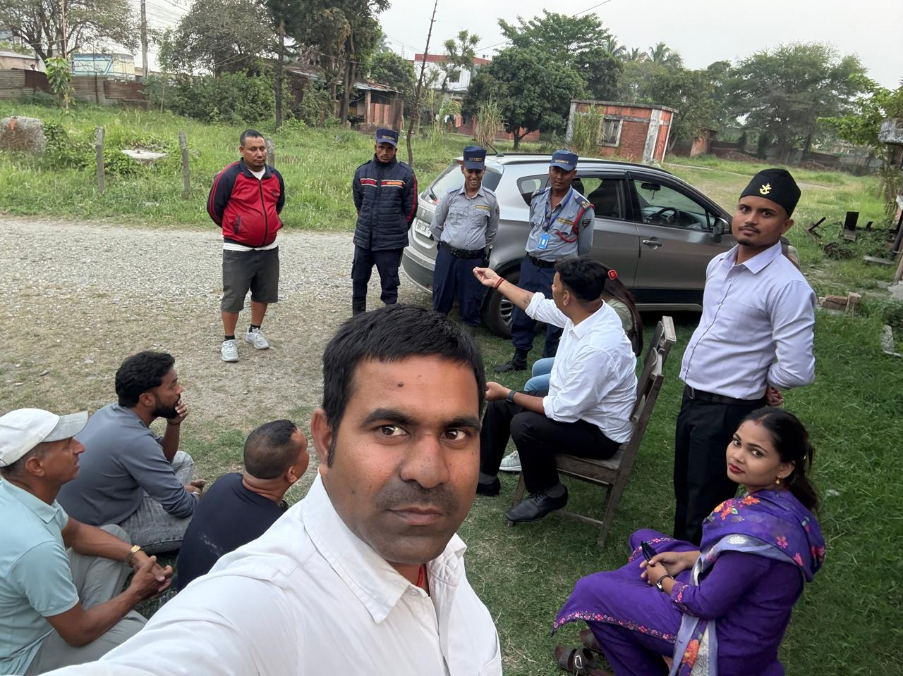
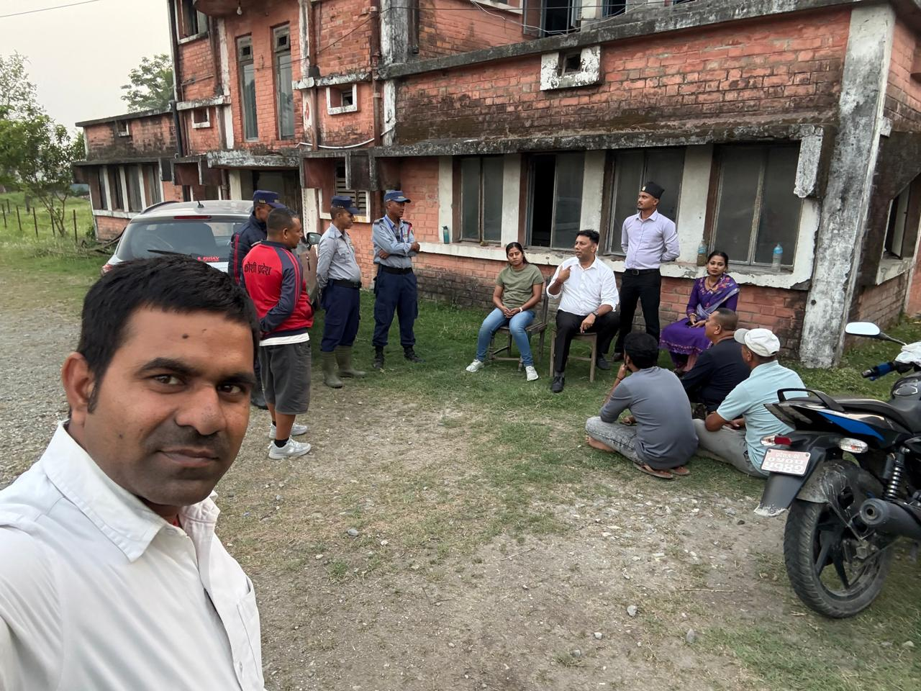
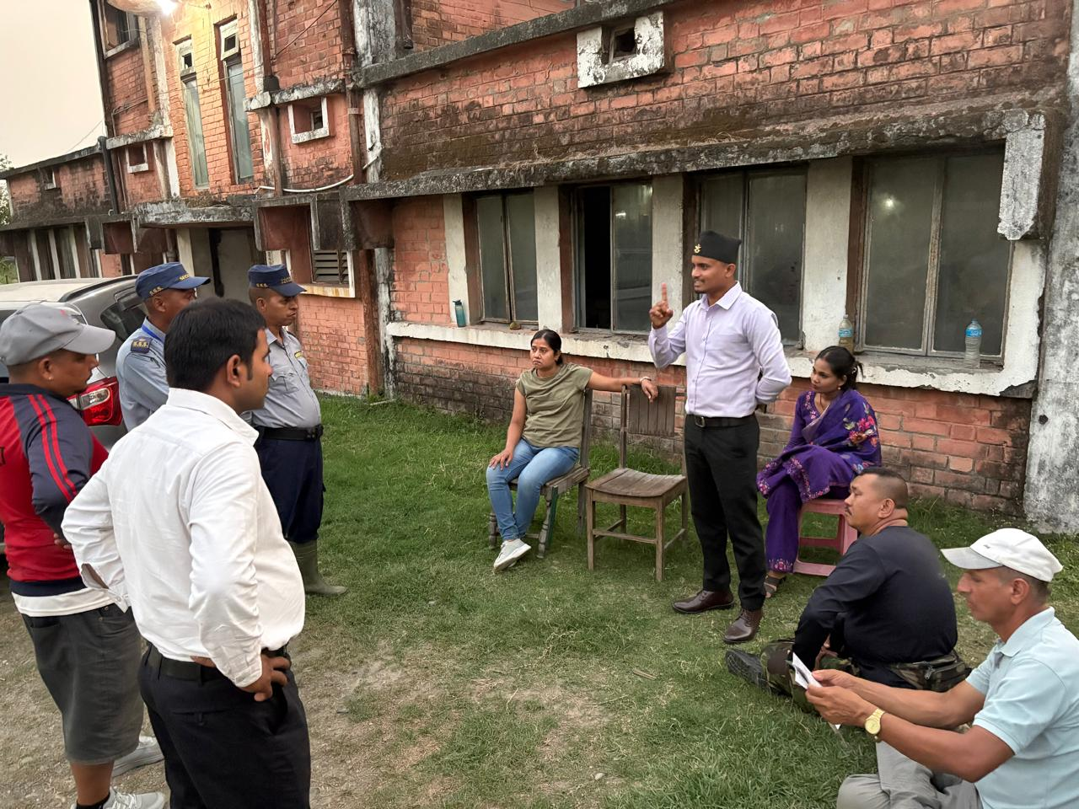
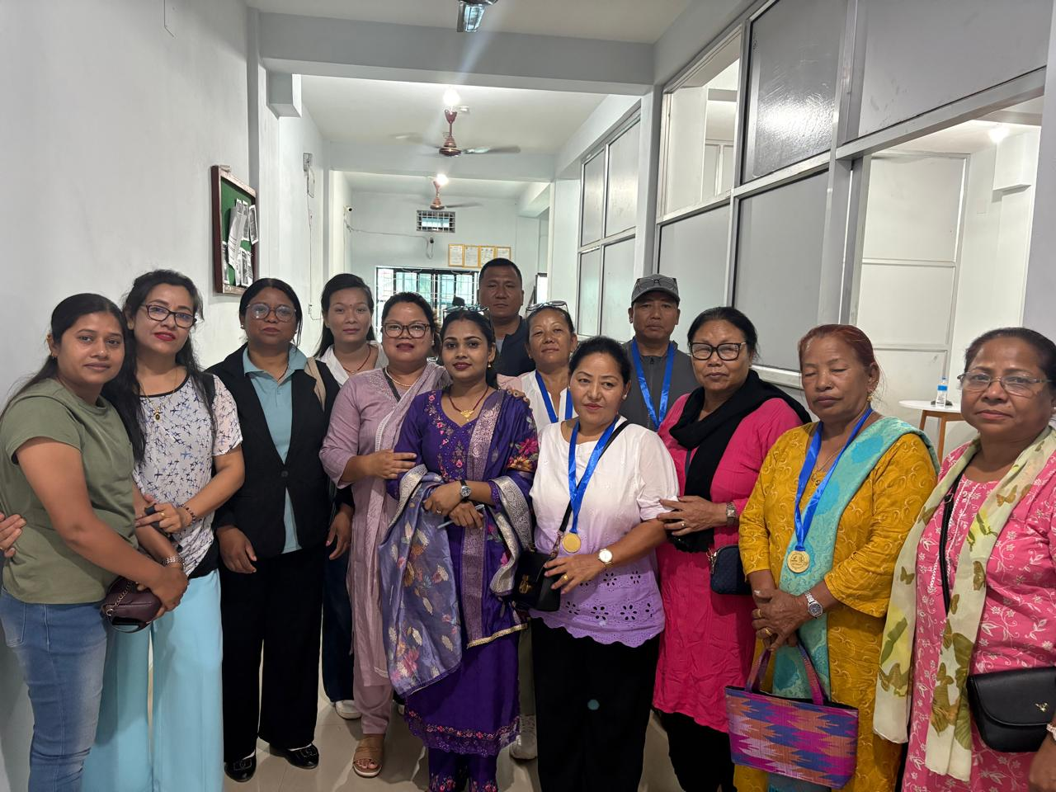
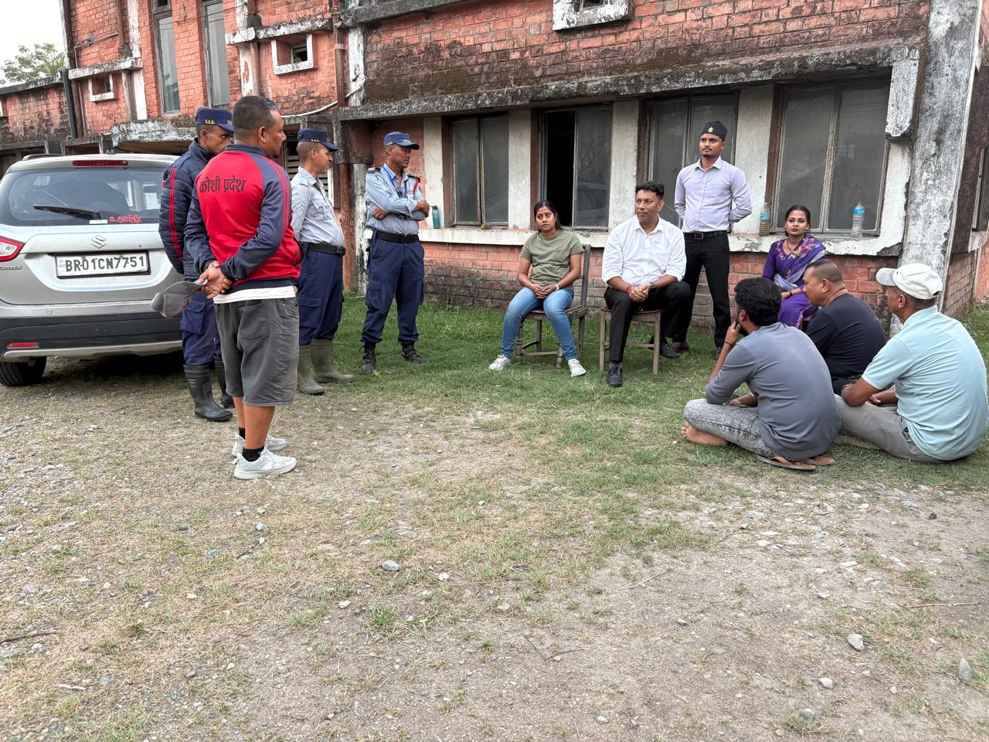
BUSINESS MOMENTUM

Slide 7
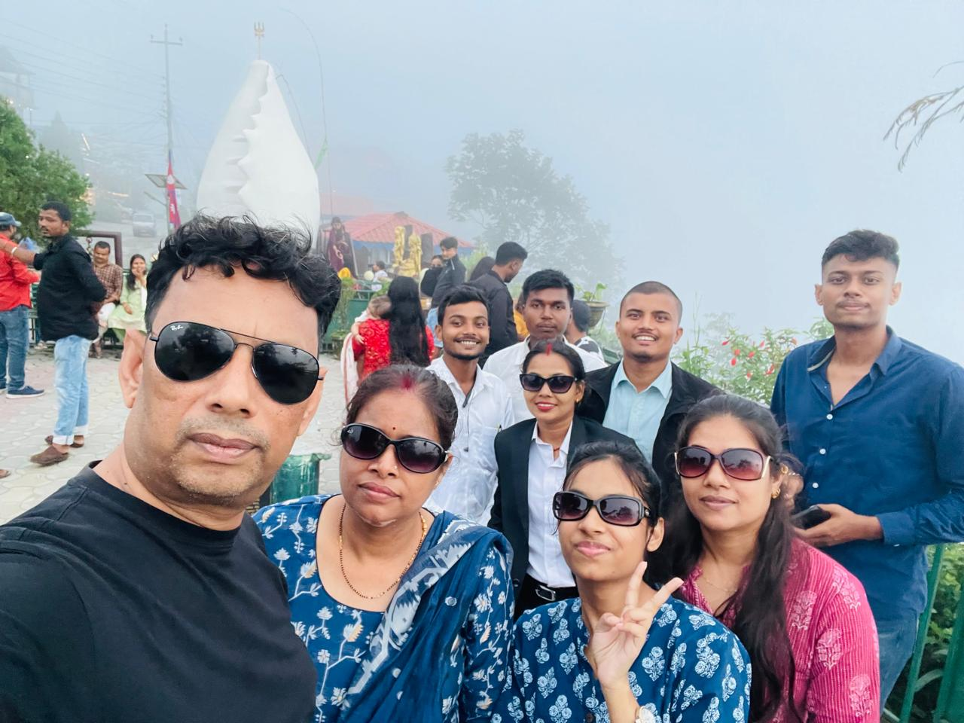
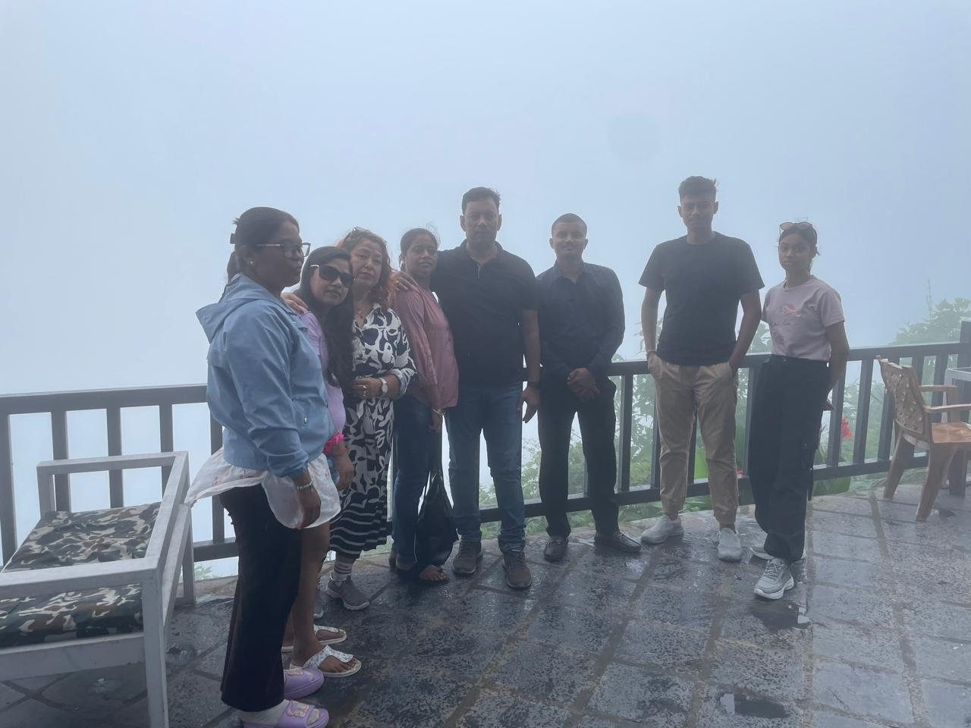
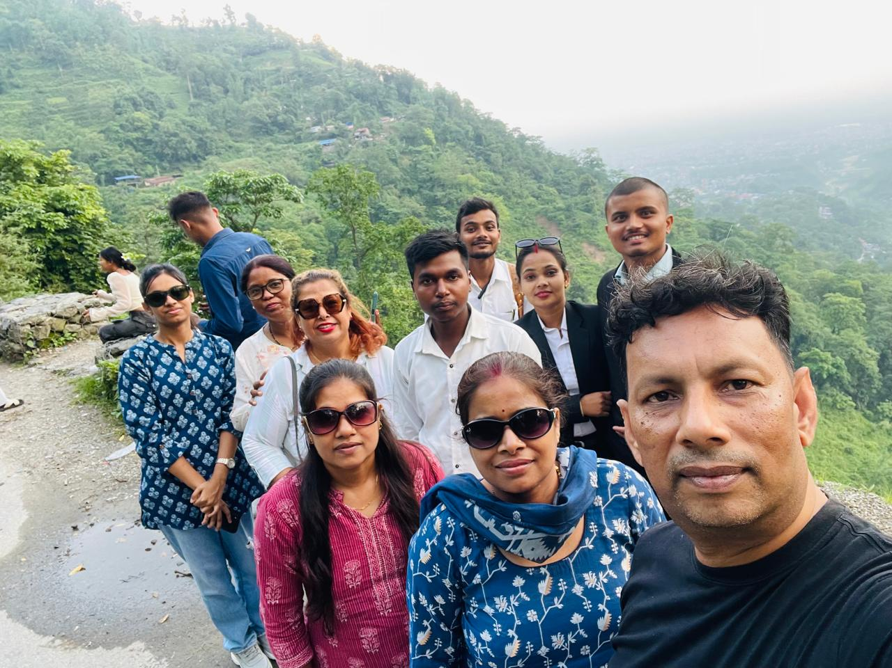
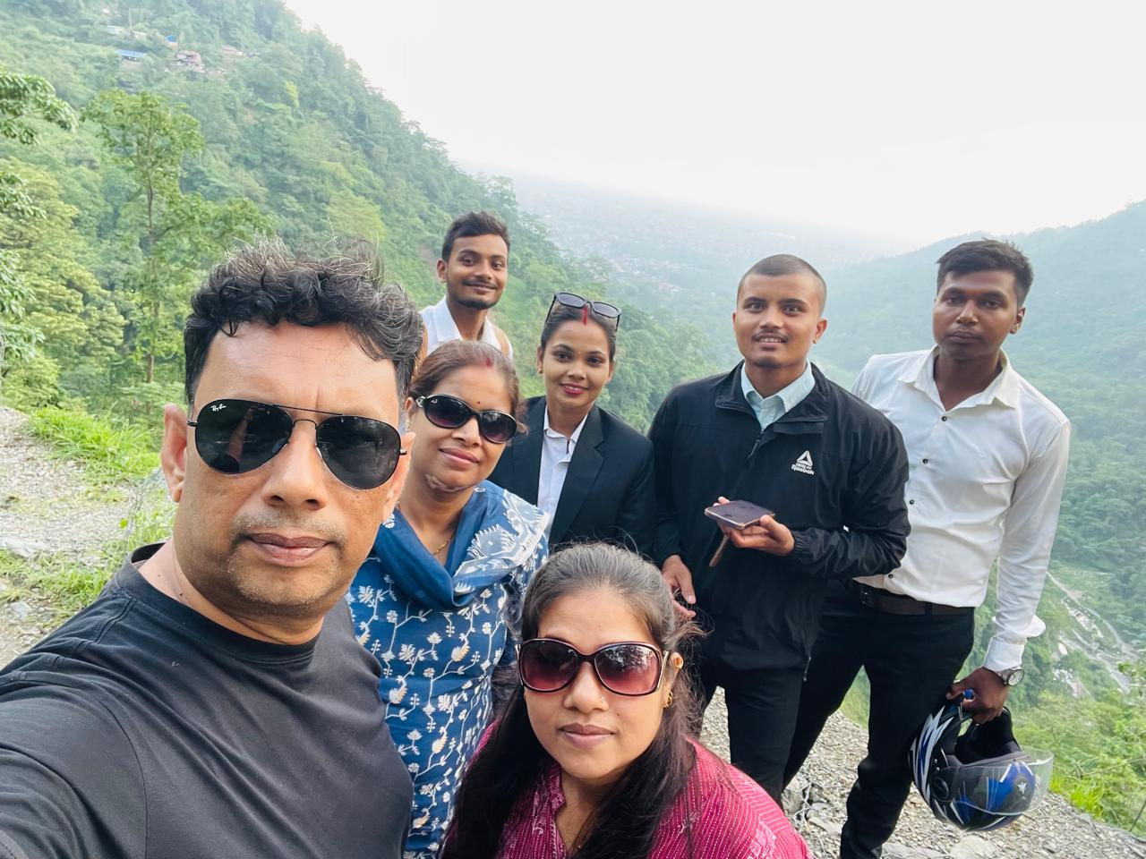
FAMILY TRIP WITH TEAM

Slide 8
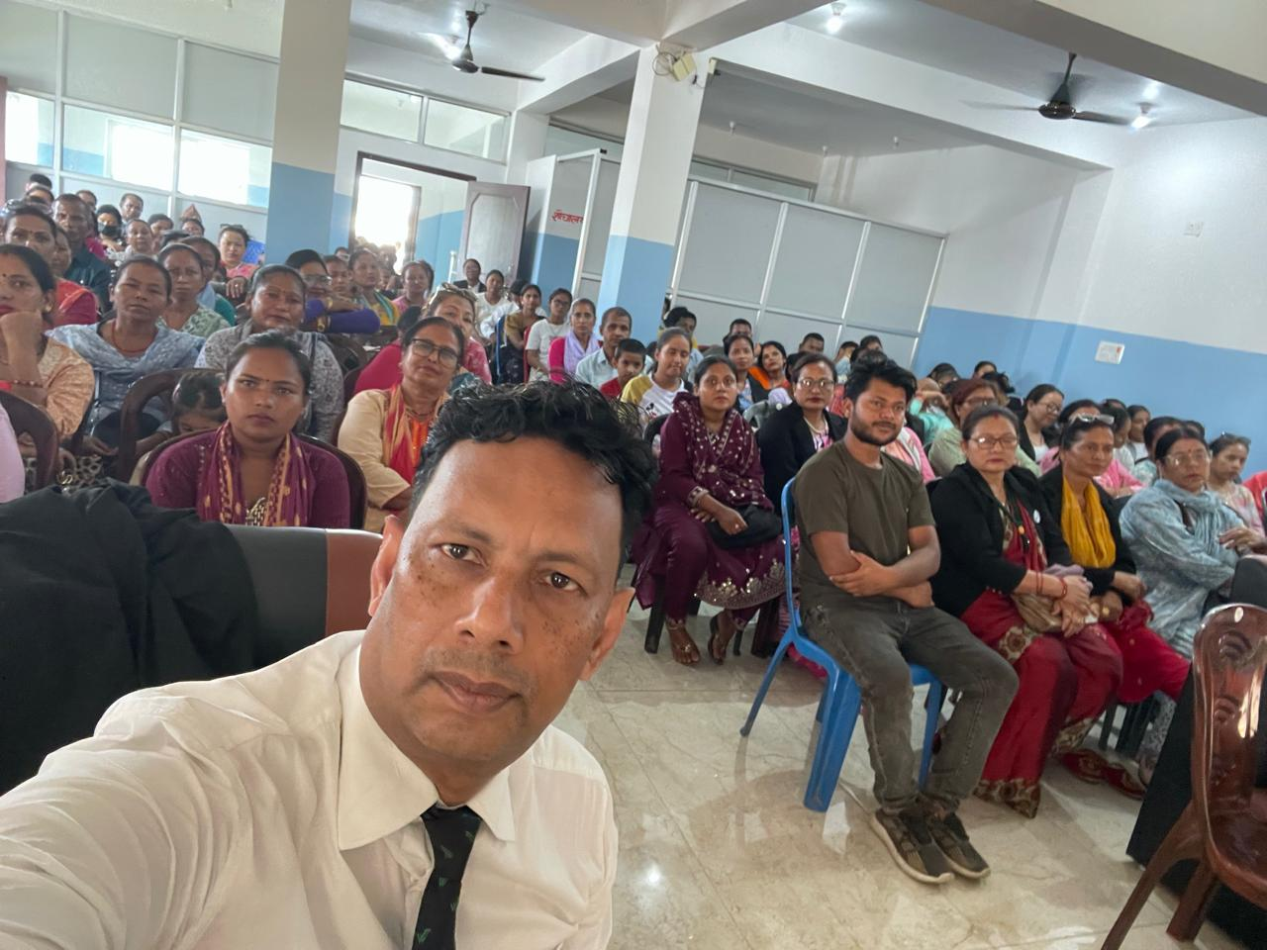
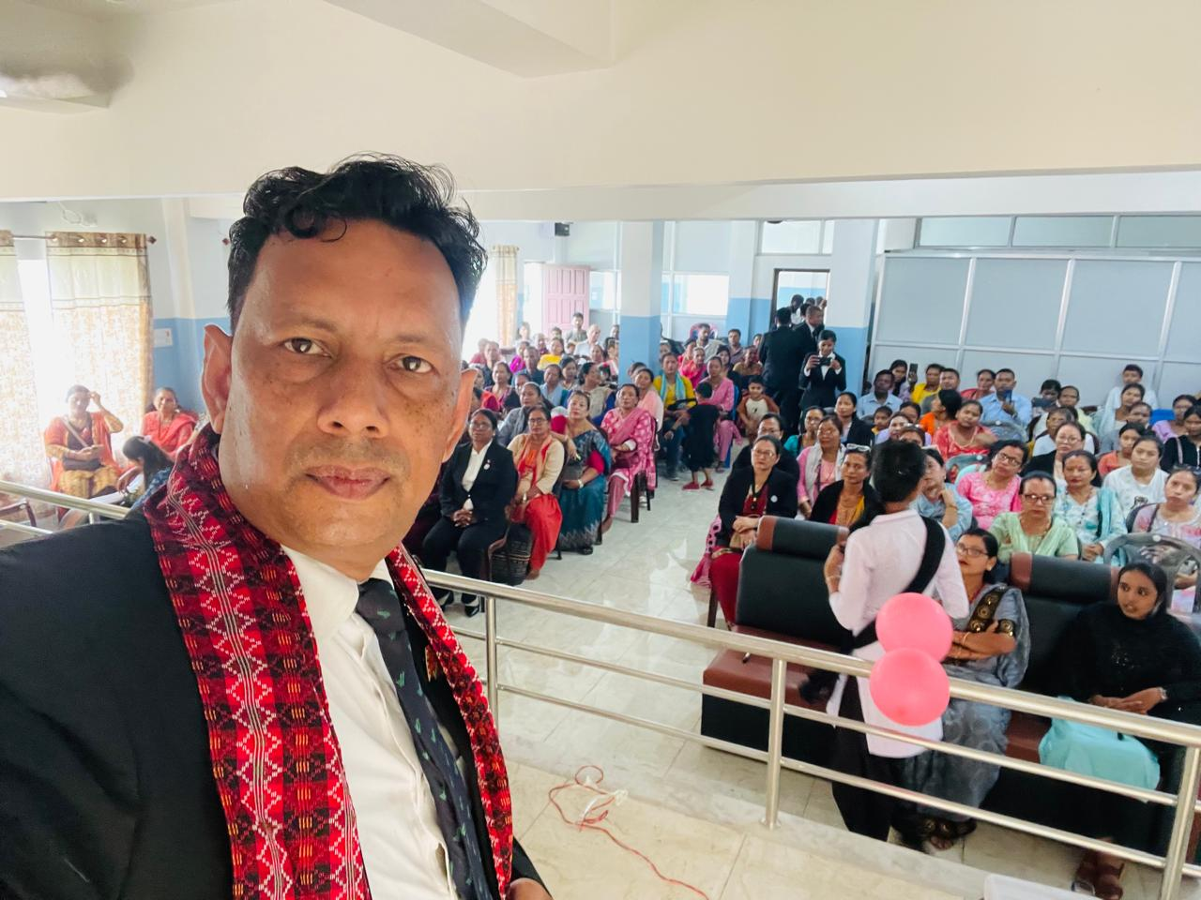
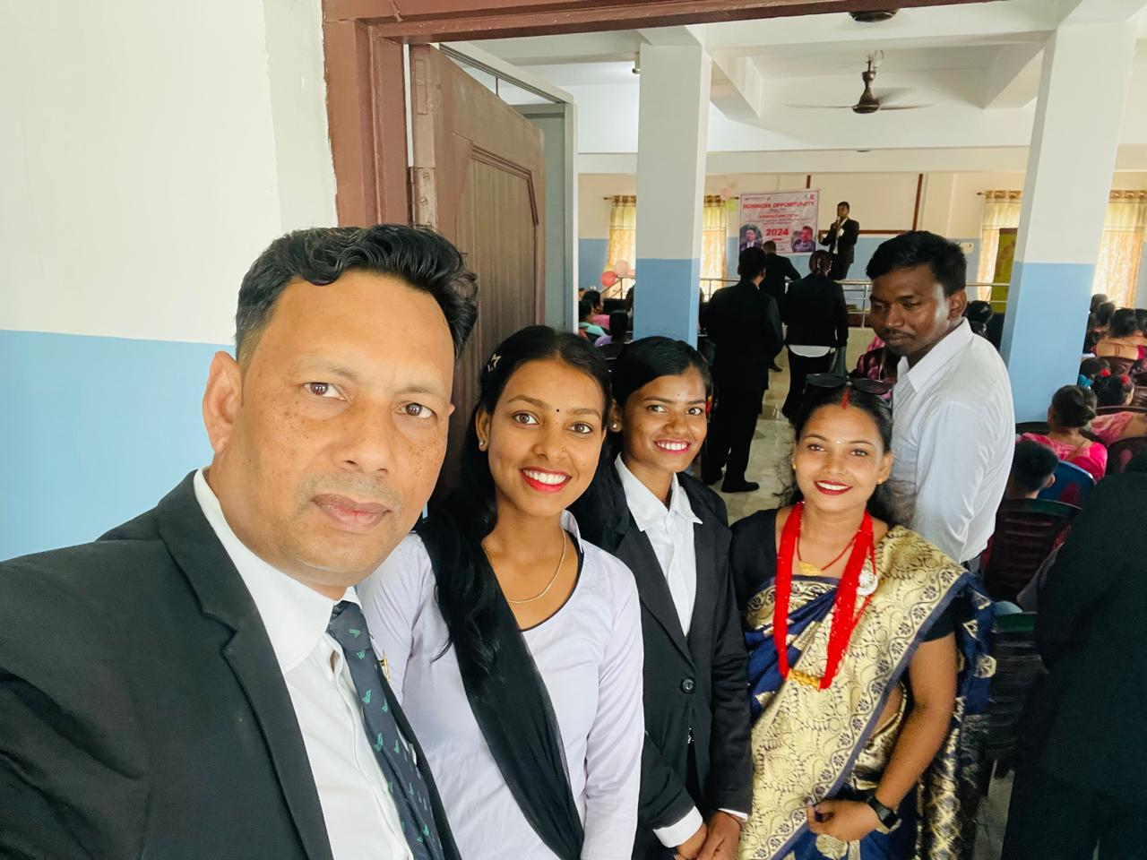
NEED MORE ACTIVITY FOR MOMENTUM

Slide 9
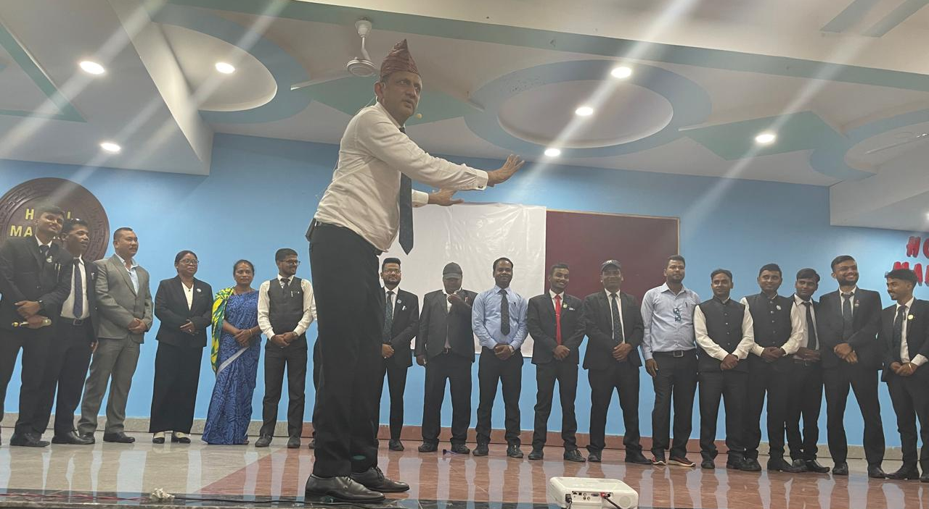
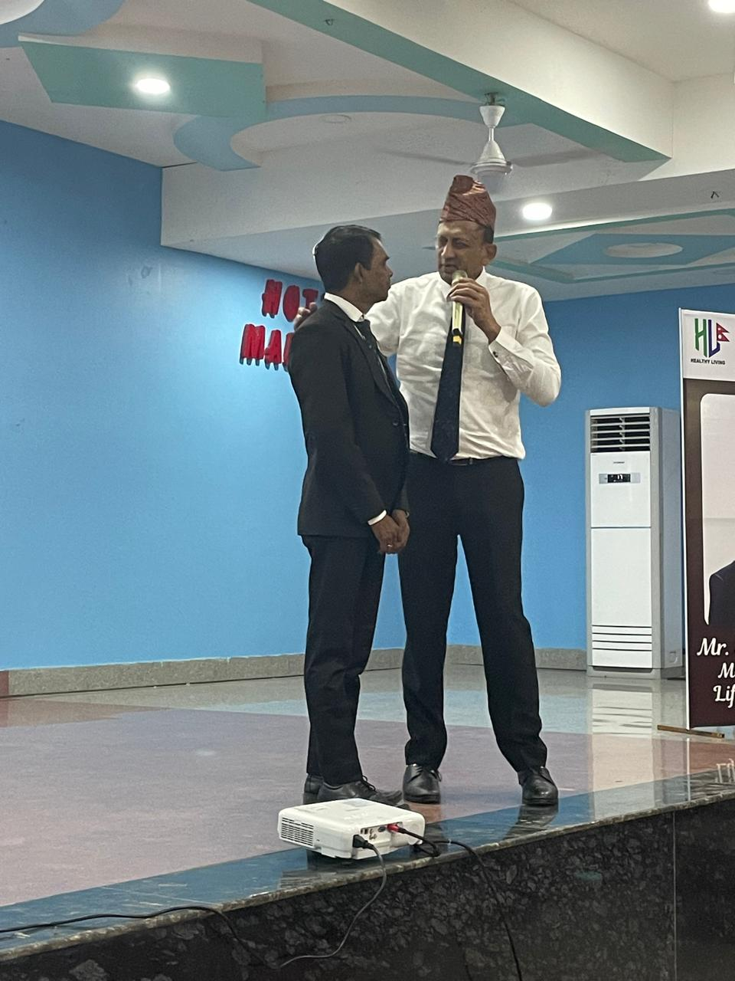
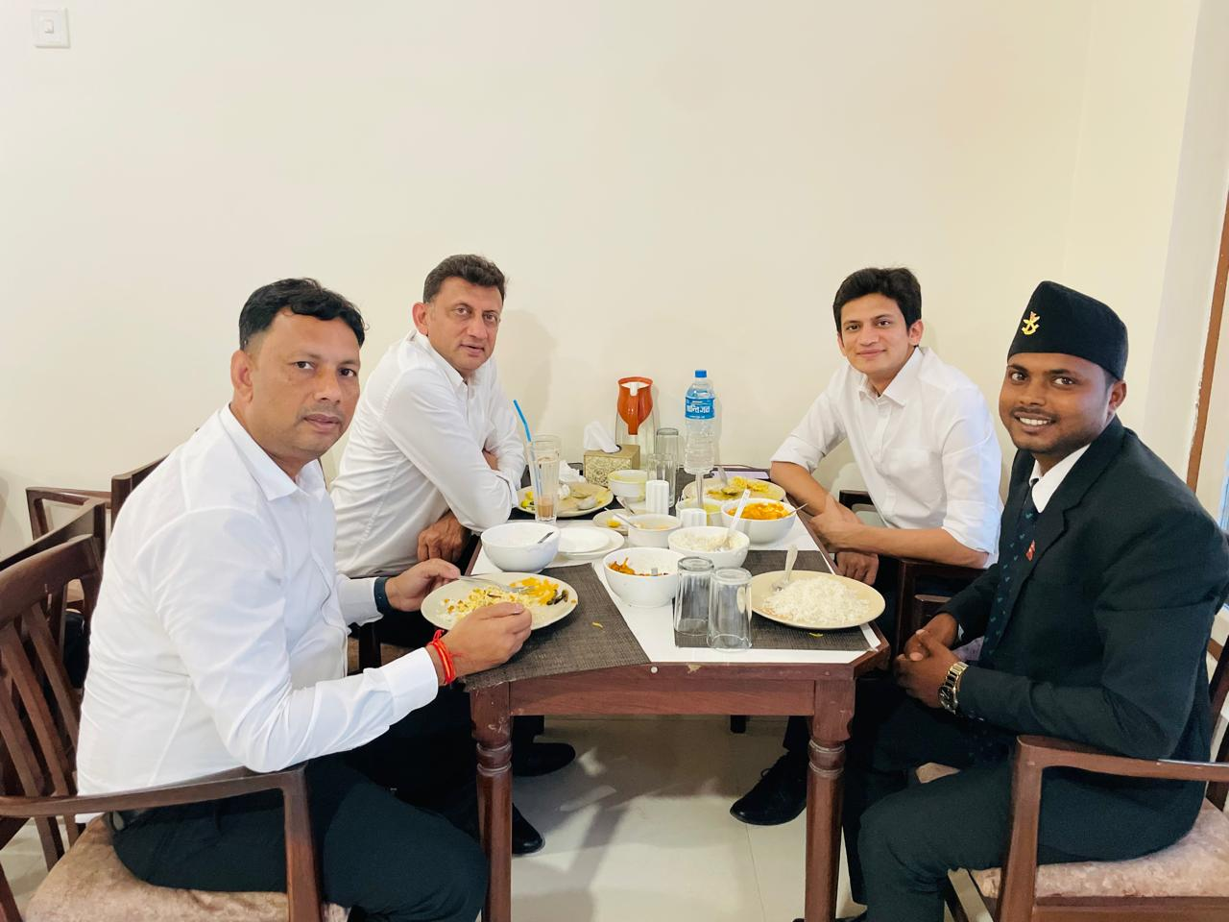
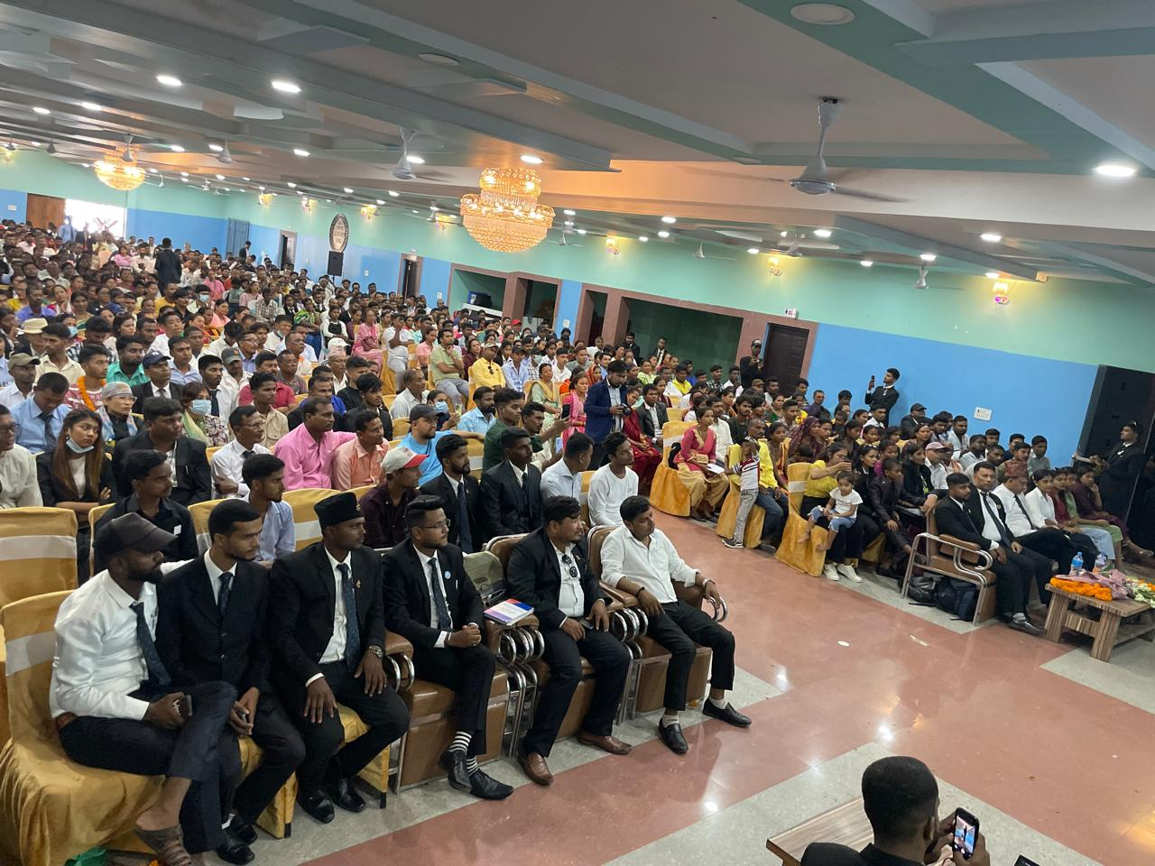
UPLINE INVOLVE

Slide 10
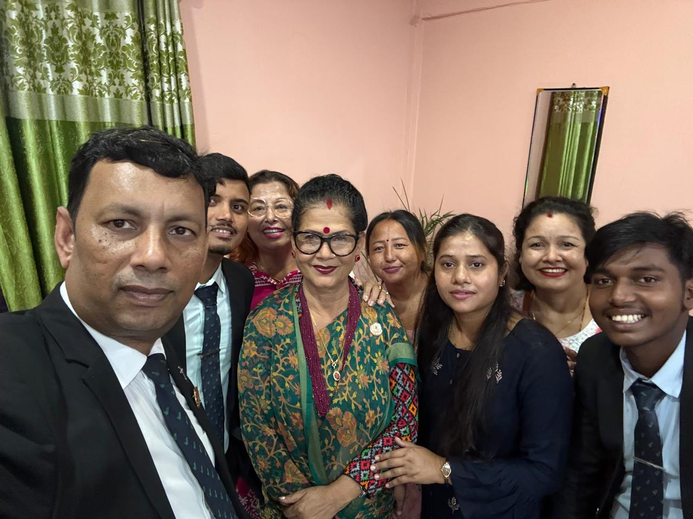
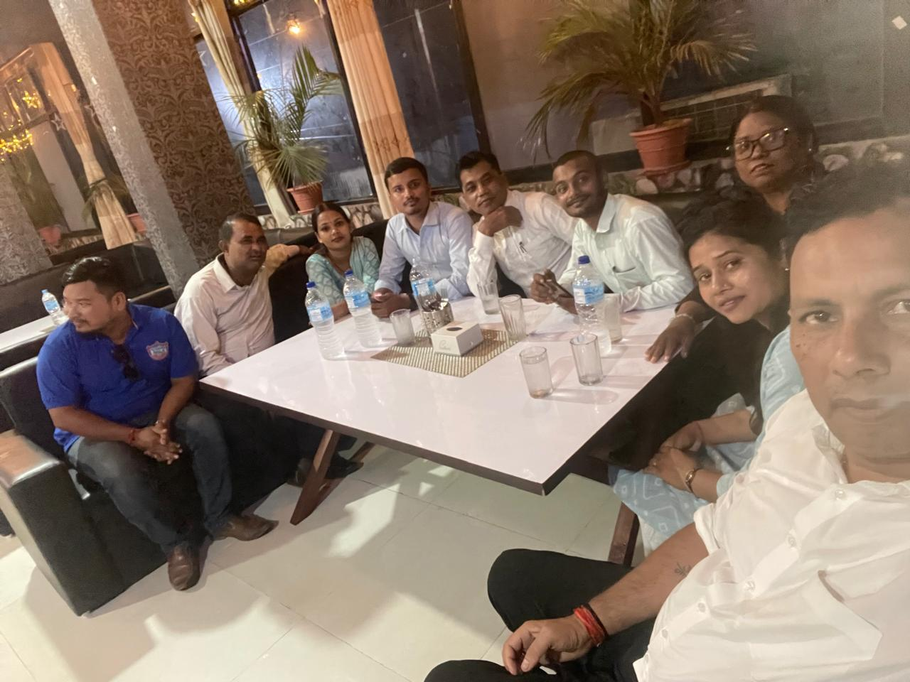
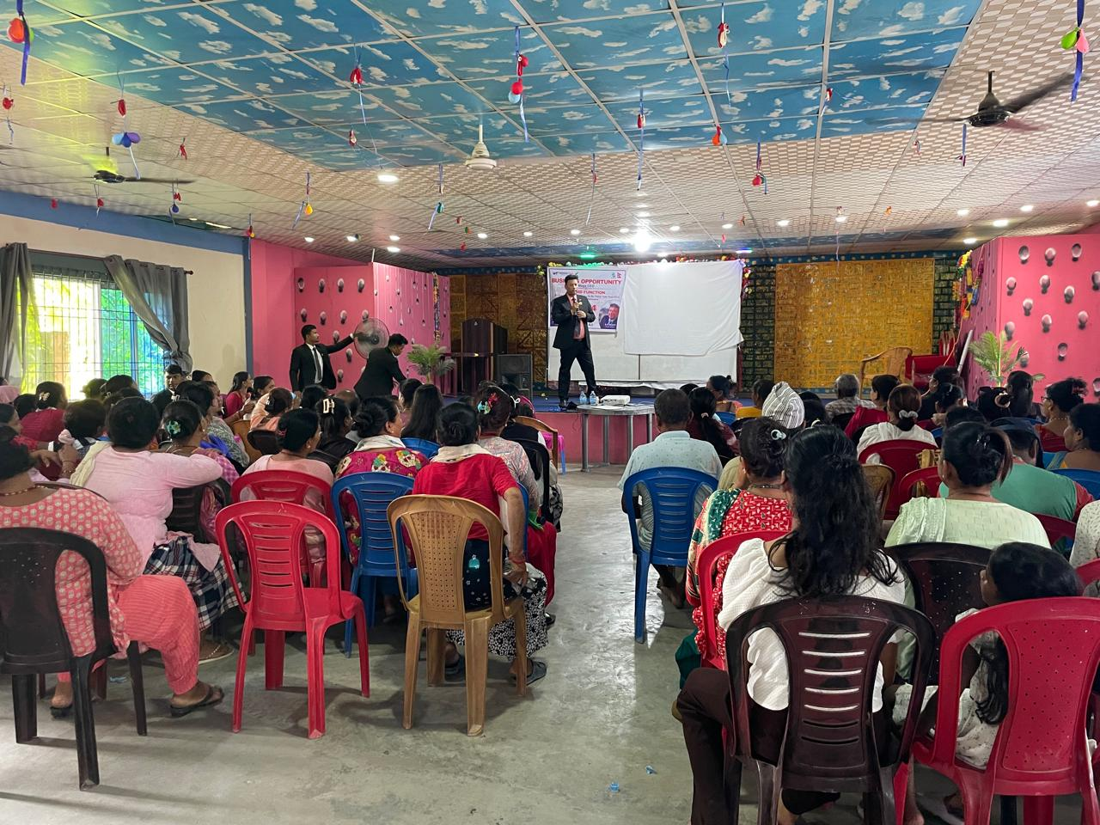
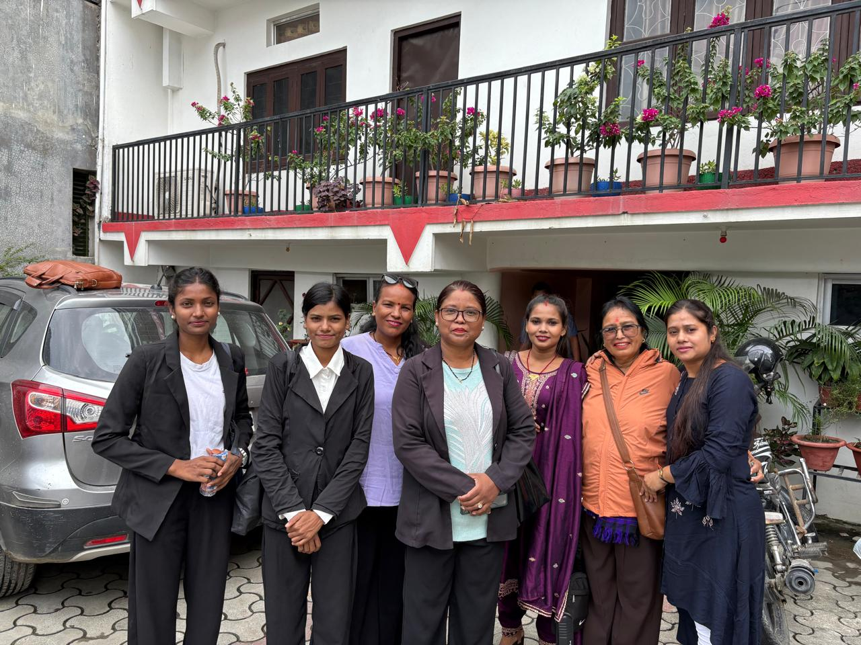
DINNER WITH LEADERSHIP

Slide 11
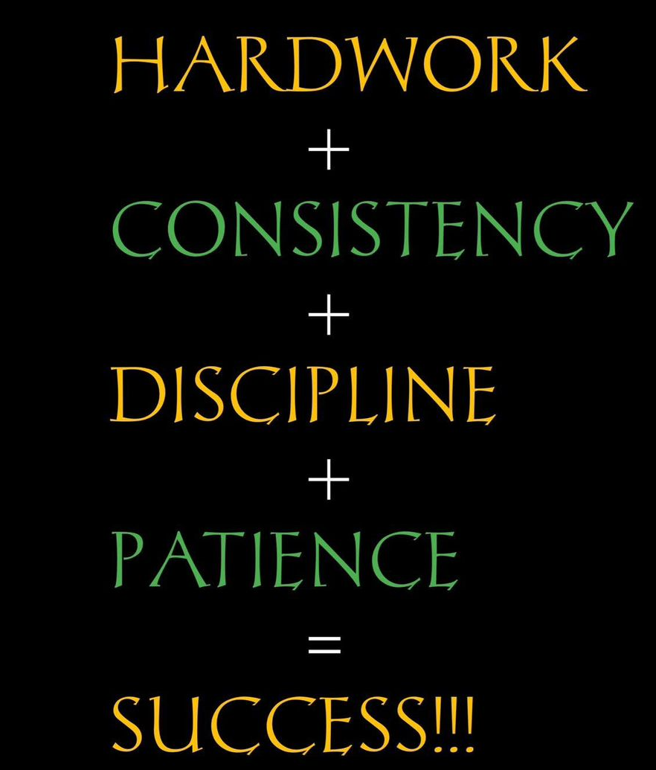
ALWAYS NEED

Slide 12
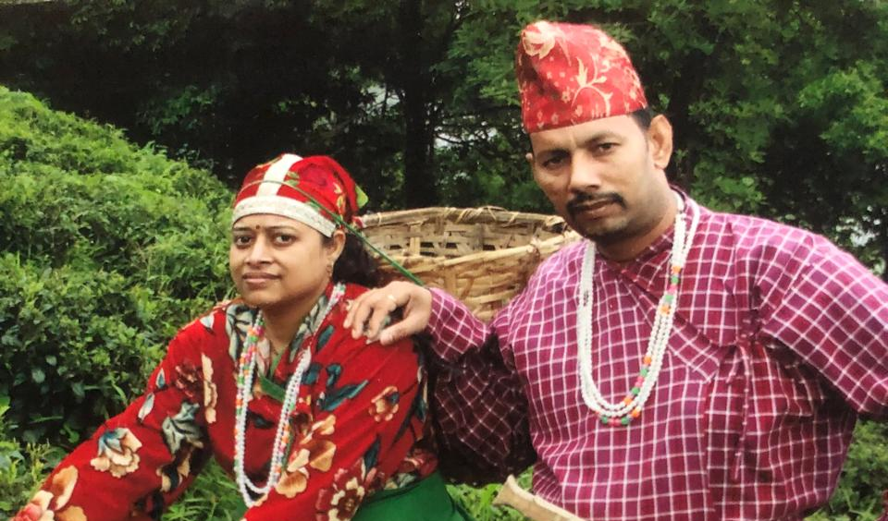
THANK YOU SO MUCH

